Slide 1
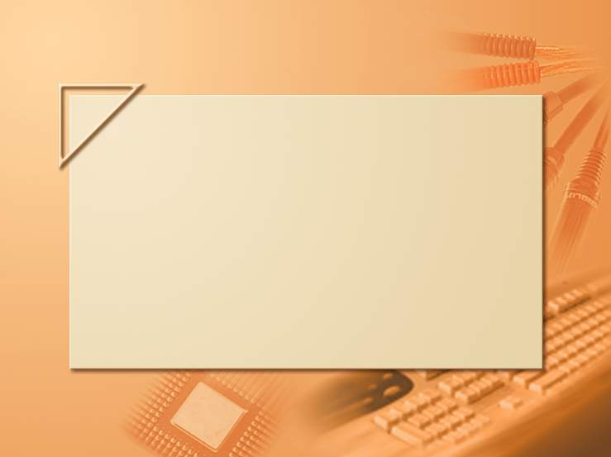
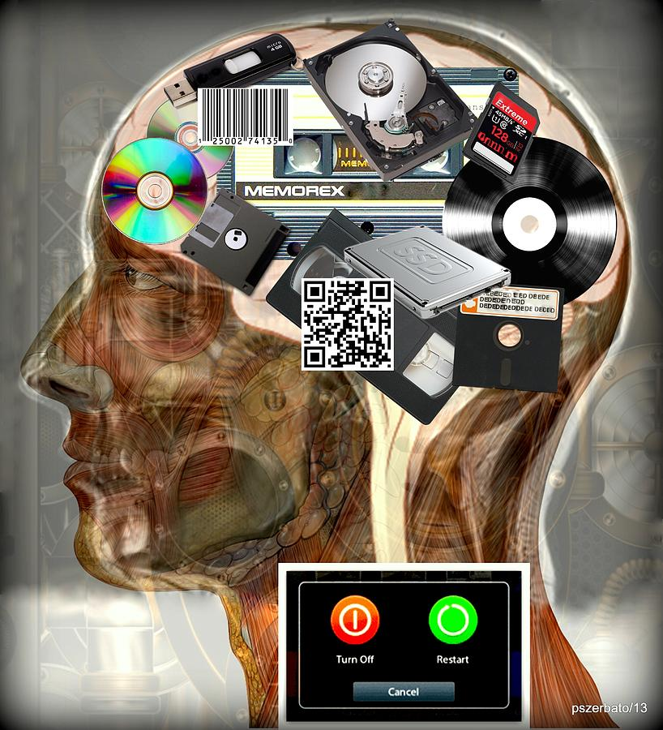
Introduction to Computer Science
Reichman University
Lecture 6-1
Multimedia, Part II
Notes:
1

Slide 2
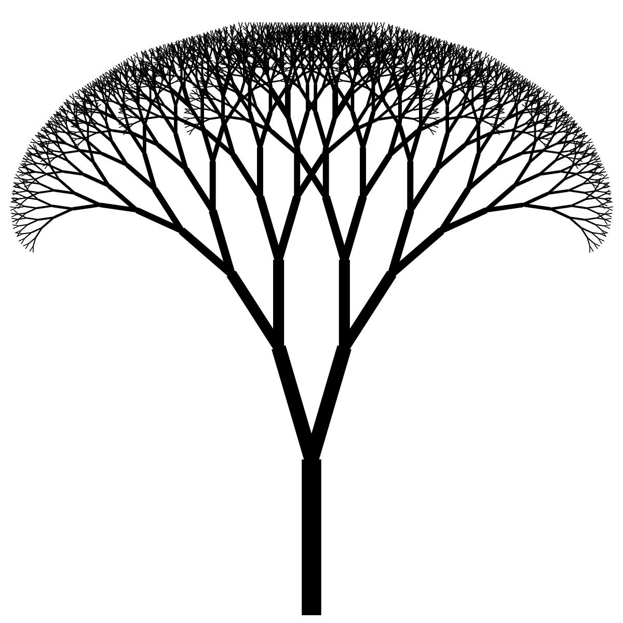
Lecture plan
Text
Graphics
Animation
Audio

Slide 3
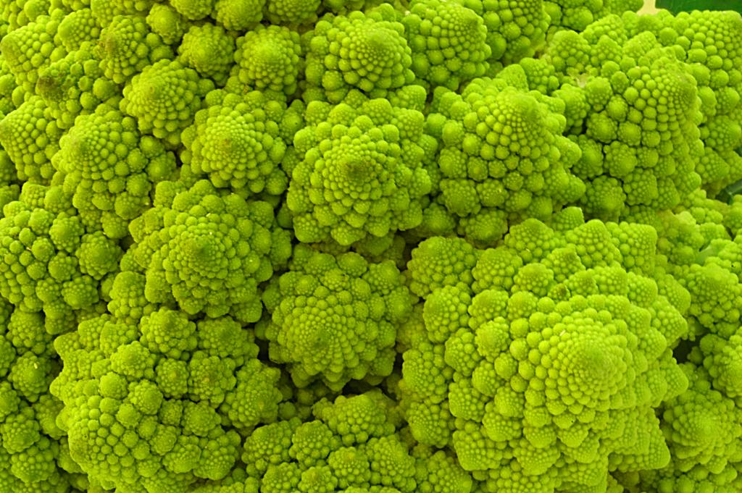
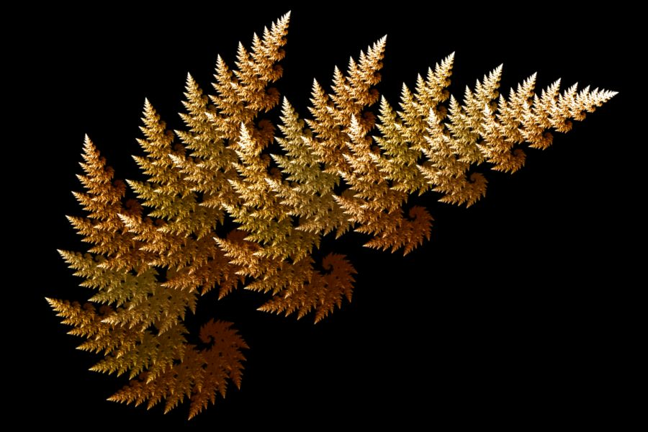
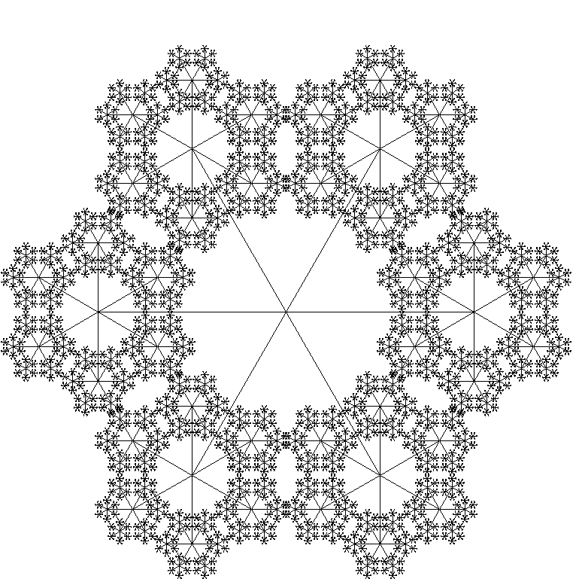
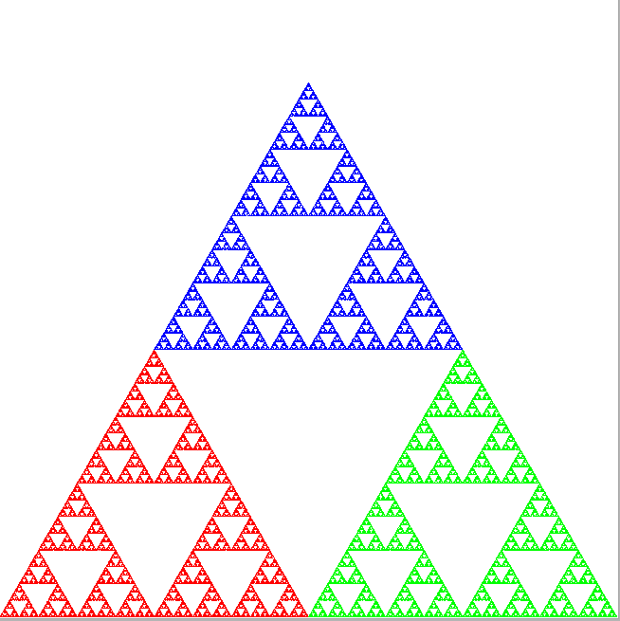
Graphics
Fractals: self-replicating patterns
Fractal: The deeper you dive into the image, the more you see the same image

Slide 4
Graphics
Fractals: self-replicating patterns
Example: the self-replicating “Sierpinski triangle”

Slide 5
Graphics
Fractals: self-replicating patterns
Example: the self-replicating “Sierpinski triangle”
Algorithm
Construct an equilateral triangle with vertices R, G, B;
current point = R
repeat N times:
target = random point (R, G, or B)
compute the halfway point between the current point and the target
draw this point using the chosen color
currentPoint = target
B
R
G

Slide 6
Graphics
Fractals: self-replicating patterns
Example: the self-replicating “Sierpinski triangle”
Algorithm
Construct an equilateral triangle with vertices R, G, B;
current point = R
repeat N times:
target = random point (R, G, or B)
compute the halfway point between the current point and the target
draw this point using the chosen color
currentPoint = target
B
2
5
1
3
6
7
4
8
9
0
R
G

Slide 7
Graphics
Fractals: self-replicating patterns
Example: the self-replicating “Sierpinski triangle”
Algorithm
Construct an equilateral triangle with vertices R, G, B;
current point = R
repeat N times:
target = random point (R, G, or B)
compute the halfway point between the current point and the target
draw this point using the chosen color
currentPoint = target
B
R
After N = 100000 iterations...
G

Slide 8
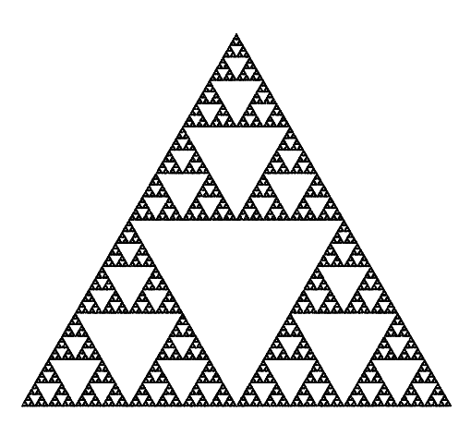
Graphics
Fractals: self-replicating patterns
Example: the self-replicating “Sierpinski triangle”
Algorithm
Construct an equilateral triangle with vertices 0, 1, 2;
current point = 0
repeat N times:
target = random point (0, 1, or 2)
compute the halfway point between the current point and the target
draw this point using the chosen color
currentPoint = target
% java Sierpinski 100000
2
0
1
Black and white version

Slide 9
Graphics
Fractals: self-replicating patterns
Example: the self-replicating “Sierpinski triangle”
Algorithm
Construct an equilateral triangle with vertices 0, 1, 2;
current point = 0
repeat N times:
target = random point (0, 1, or 2)
compute the halfway point between the current point and the target
draw this point using the chosen color
currentPoint = target
% java Sierpinski 100000
(½, ½√3)
(0, 0)
canvas = unit square
(1, 0)
0 1 2
xVertex = { 0.0, 1.0, 0.5 };
yVertex = { 0.0, 0.0, 0.866 };

Slide 10
Graphics
Fractals: self-replicating patterns
Example: the self-replicating “Sierpinski triangle”
public class Sierpinski {
public static void main(String[] args) {
// Gets the number of iterations
int N = Integer.parseInt(args[0]);
// Sets the coordinates of the triangle's vertices
double[] xVertex = { 0.0, 1.0, 0.5 };
double[] yVertex = { 0.0, 0.0, 0.866 };
double x = 0.0, y = 0.0;
for (int i = 0; i < N; i++) {
// Chooses a random index from (0, 1, 2),
// and draws the midpoint
int r = (int) (Math.random() * 3);
x = (x + xVertex[r]) / 2.0;
y = (y + yVertex[r]) / 2.0;
StdDraw.point(x, y);
}
}
}
% java Sierpinski 100000
(½, ½√3)
(0, 0)
canvas = unit square
(1, 0)
0 1 2
xVertex = { 0.0, 1.0, 0.5 };
yVertex = { 0.0, 0.0, 0.866 };

Slide 11
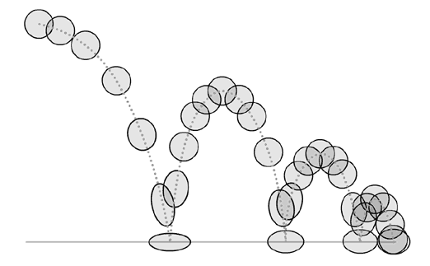
Lecture plan
Text
Graphics
Animation
Audio

Slide 12
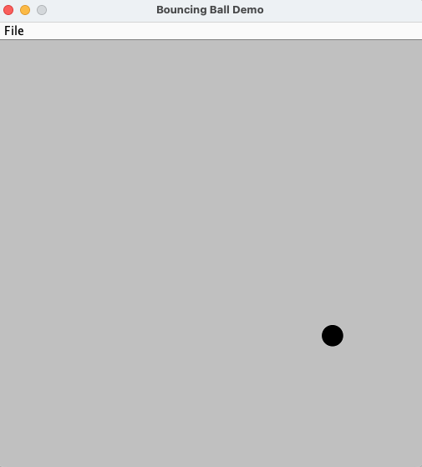
Example 2: Animation
% java BouncingBall
Notes:
apply standard graphics technique to create the illusion of movement

Slide 13
Bouncing ball
Bouncing ball physics
At any given time, the ball has a position (x, y) and a velocity (vx, vy)
Idealized assumptions: constant velocity, no friction, no loss of energy
To compute where the ball will end up in the next time unit, we add the ball’s velocity to its current position
Velocity: (vx,vy)
Speed (distance per time unit) of motion, and direction of motion
Represented by a vector that specifies the speed w.r.t to the x-axis and the y-axis
(vx, vy)
(x, y)₁
(x, y)₀
x_{t+1} = x_{t} + vx_{t}
y_{t+1} = y_{t} + vy_{t}
Notes:
apply a standard graphics technique to create the illusion of movement

Slide 14
Bouncing ball
Bouncing ball physics
At any given time, the ball has a position (x, y) and a velocity (vx, vy)
Idealized assumptions: constant velocity, no friction, no loss of energy
To compute where the ball will end up in the next time unit, we add the ball’s velocity to its current position
(vx, vy)
(x, y)₁
(x, y)₀
x_{t+1} = x_{t} + vx_{t}
y_{t+1} = y_{t} + vy_{t}

Slide 15
Bouncing ball
Bouncing ball physics
At any given time, the ball has a position (x, y) and a velocity (vx, vy)
Idealized assumptions: constant velocity, no friction, no loss of energy
To compute where the ball will end up in the next time unit, we add the ball’s velocity to its current position
When the ball hits a wall, we update its velocity according to the laws of elastic collision:
energy (velocity) is conserved
angle of collision = angle of reflection
vy_{t+1} = –vy_{t}
(x, y)₂
(x, y)₃
vx_{t+1} = –vx_{t}
(vx, vy)
(x, y)₁
(x, y)₀
x_{t+1} = x_{t} + vx_{t}
y_{t+1} = y_{t} + vy_{t}

Slide 16
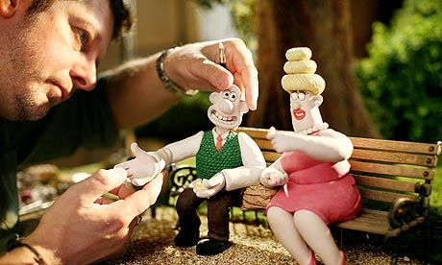
Bouncing ball
Animation technique: Stop Motion
Repeat (offscreen):
Erase the ball
Compute the ball’s next position
Draw the ball in its next position
Show: onscreen = offscreen
next
current
Notes:
apply a standard graphics technique to create the illusion of movement

Slide 17
Bouncing balls
Implementation
public class BouncingBall {
public static void main(String[] args) {
// initializes the canvas to be a -1 by -1 square,
// and enables offscreen drawing.
StdDraw.setXscale(-1.0, 1.0);
StdDraw.setYscale(-1.0, 1.0);
StdDraw.enableDoubleBuffering();
// initializes the ball's radius
double radius = 0.05;
// initializes the ball's initial position
double x = 0.480, y = 0.860;
// initializes the ball's initial velocity (speed)
double vx = 0.015, vy = 0.023;
// main animation loop
while (true) {
//// next slide...
(-1, 1)
(1, 1)
(x, y)₂
(x, y)₃
(vx, vy)
(x, y)₁
(x, y)₀
(-1, -1)
2 by 2 canvas
(1, -1)

Slide 18
Bouncing balls
Implementation
public class BouncingBall {
public static void main(String[] args) {
// initializes the canvas and the ball’s values... (previous slide)
// main animation loop
while (true) {
// if the ball hits the wall, update the velocity
// according to law of elastic collision
if (Math.abs(x + vx) > 1.0 - radius) vx = -vx;
if (Math.abs(y + vy) > 1.0 - radius) vy = -vy;
// updates ball’s position
x = x + vx;
y = y + vy;
// clears the canvas, and re-draws the ball
StdDraw.clear(StdDraw.LIGHT_GRAY);
StdDraw.setPenColor(StdDraw.BLACK);
StdDraw.filledCircle(x, y, radius);
// copies offscreen buffer to onscreen, and pauses briefly
StdDraw.show();
StdDraw.pause(20);
}
}
}
(-1, 1)
(1, 1)
(x, y)₂
(x, y)₃
(vx, vy)
(x, y)₁
(x, y)₀
(-1, -1)
(1, -1)

Slide 19
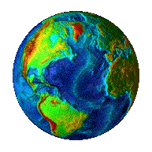

Bouncing balls
Special effects:
Instead of drawing a boring sphere, draw some image:
When hitting a wall, make a sound effect:
earth.gif
laser.wav
pop.wav
Implementation:
StdDraw.picture(x, y, "earth.gif"); // Draws the image at location (x, y)
StdAudio.play("laser.wav"); // Makes sounds

Slide 20

Bouncing balls
Special effects

Slide 21
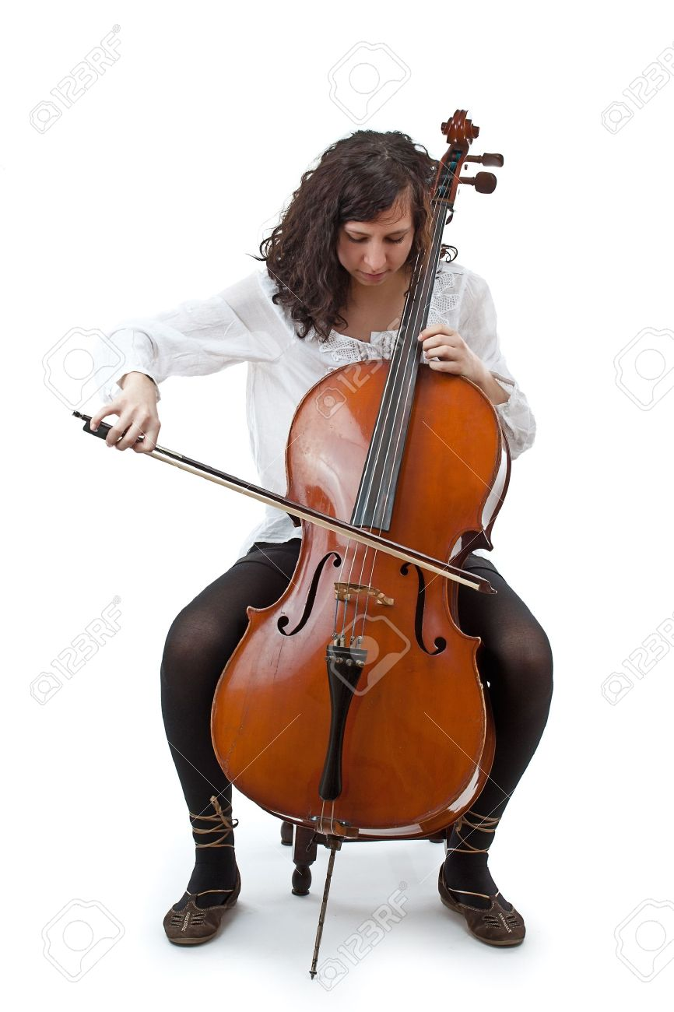
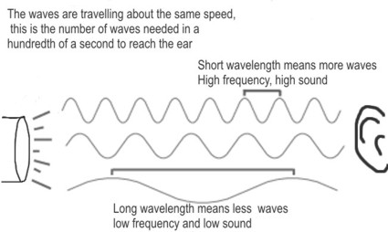
Lecture plan
Text
Graphics
Animation
Audio

Slide 22
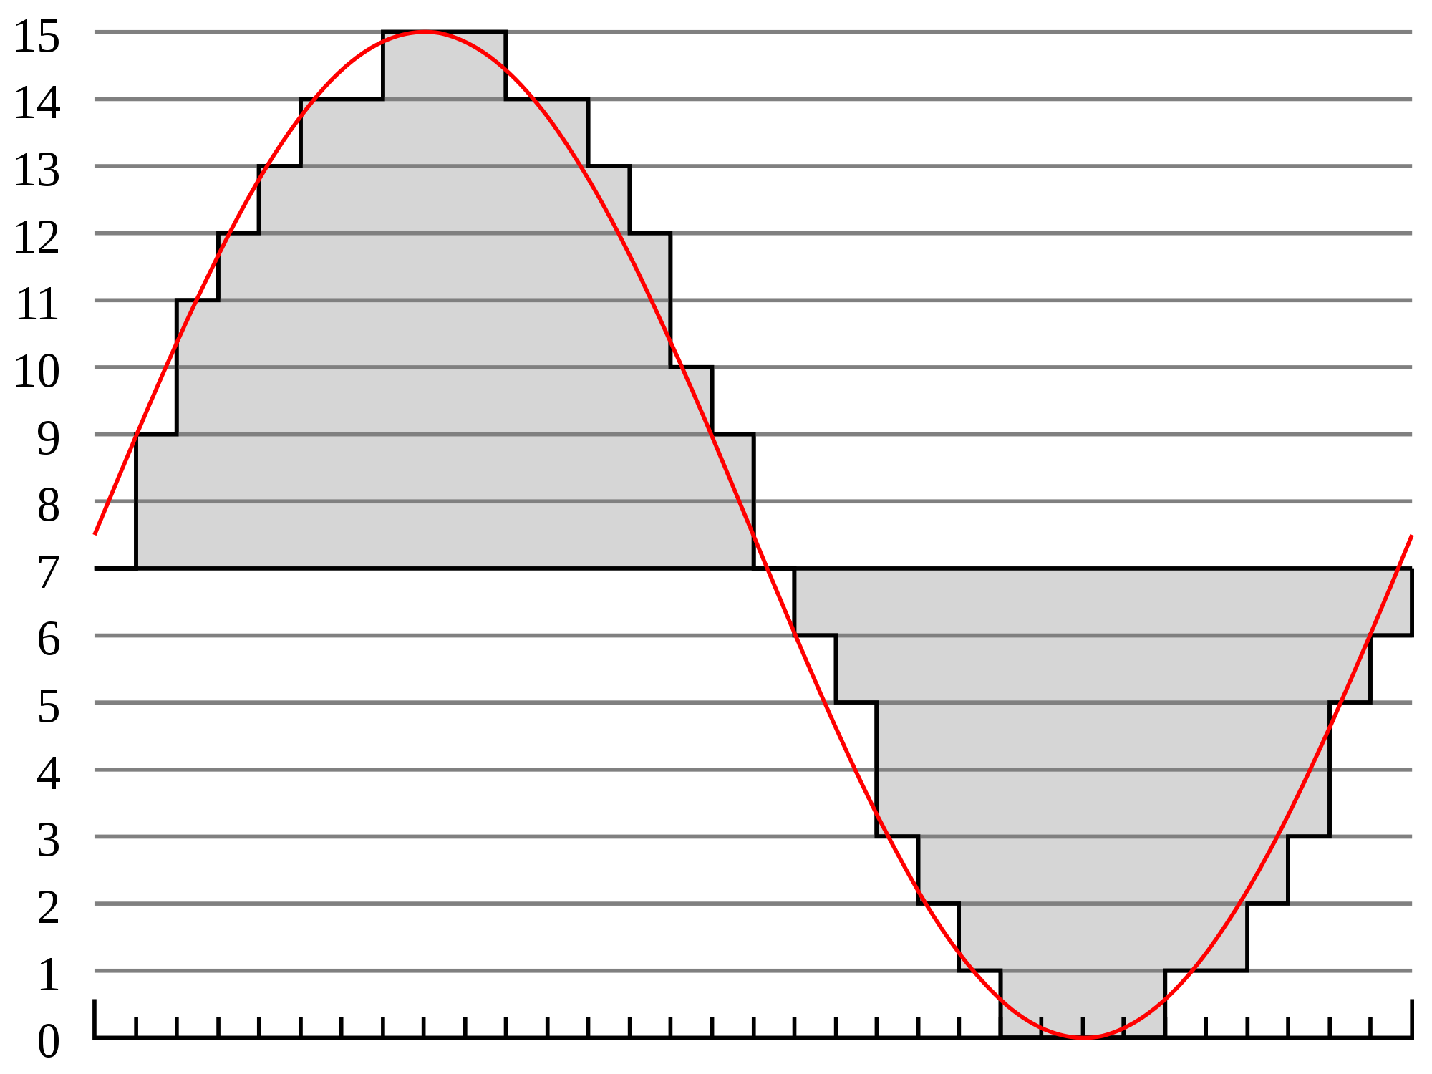
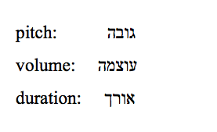
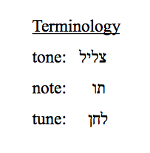
Sound crash course
sound = wave

Slide 23
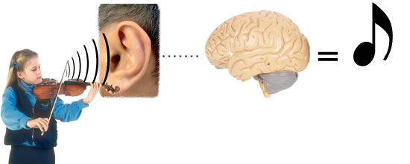
Sound crash course
Sound
A perception in the brain caused by vibration of molecules in the eardrums
Note (תו)
Tone (צליל)
Tone: The pitch of the sound (wave frequency) that we hear
Note: Selected pitch values are called notes (תווים)
Tune: Combination of notes that sounds “right” to our brain.
Notes:
When you play an A by plucking a guitar string, pushing air through a trumpet, or causing a small cone to vibrate in a speaker, this sine wave is the prominent part of the sound that you hear and is recognizable as concert A. We measure frequency in hertz (cycles per second). When you double or halve the frequency, you move up or down an octave on the scale. For example 880 hertz is one octave above concert A and 110 hertz is two octaves below concert A. For reference, the frequency range of human hearing is about 20 to 20,000 hertz.

Slide 24
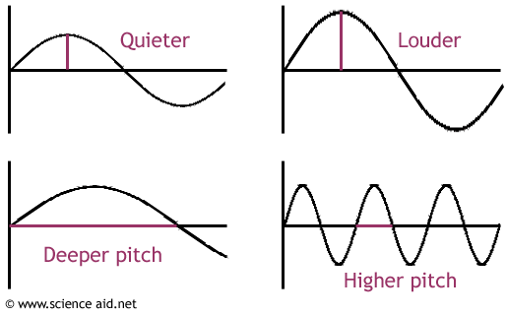
Sound crash course
Sound can be modeled using a sin(x) function with two properties:
volume
Pitch = frequency:
Number of cycles per second, measured in Hertz (Hz).

Slide 25
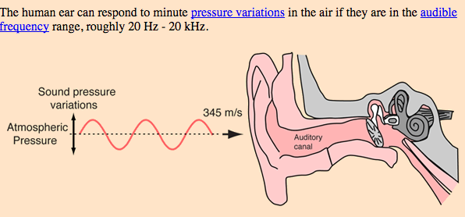
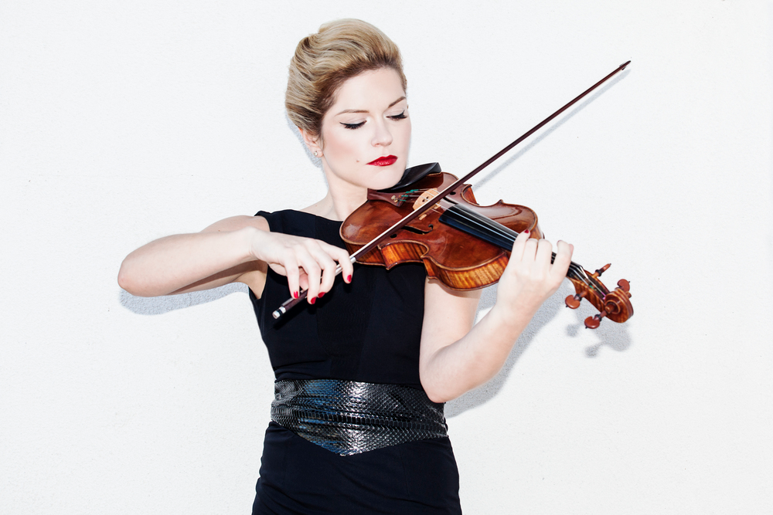
Pitch
lower frequency, lower pitch
higher frequency, higher pitch
Audible sensitivity:
humans: 20 - 20,000 Hz
dogs: 67 – 45,000 Hz
mice: 1 – 70,000 Hz
bats: 1 – 200,000 Hz

Slide 26
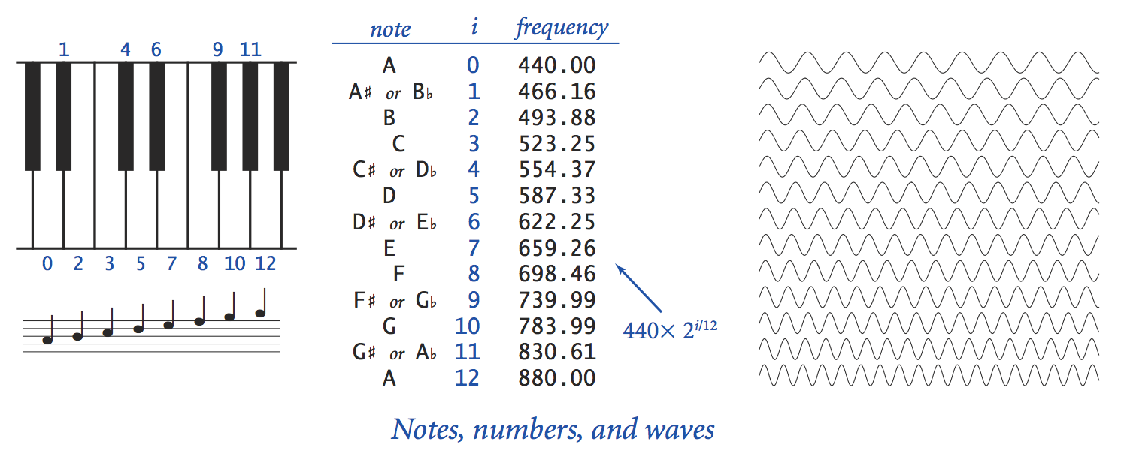
Chromatic scale
Selected 12 notes from 440 Hz to 880 Hz:
(pitch)
pitch(i) = 440 * 2^{i/12}
% java Sound 523.25
(plays Do)
% java Sound 587.33
(plays Re)
% java Sound 659.26
(plays Mi)
Example:
The note “concert-C” (Do) is represented by a sine wave, scaled to oscillate at 523.25 Hz (cycles per second)

Slide 27
Digitized sound
Computers can render sound by generating a simulated sound wave

Slide 28
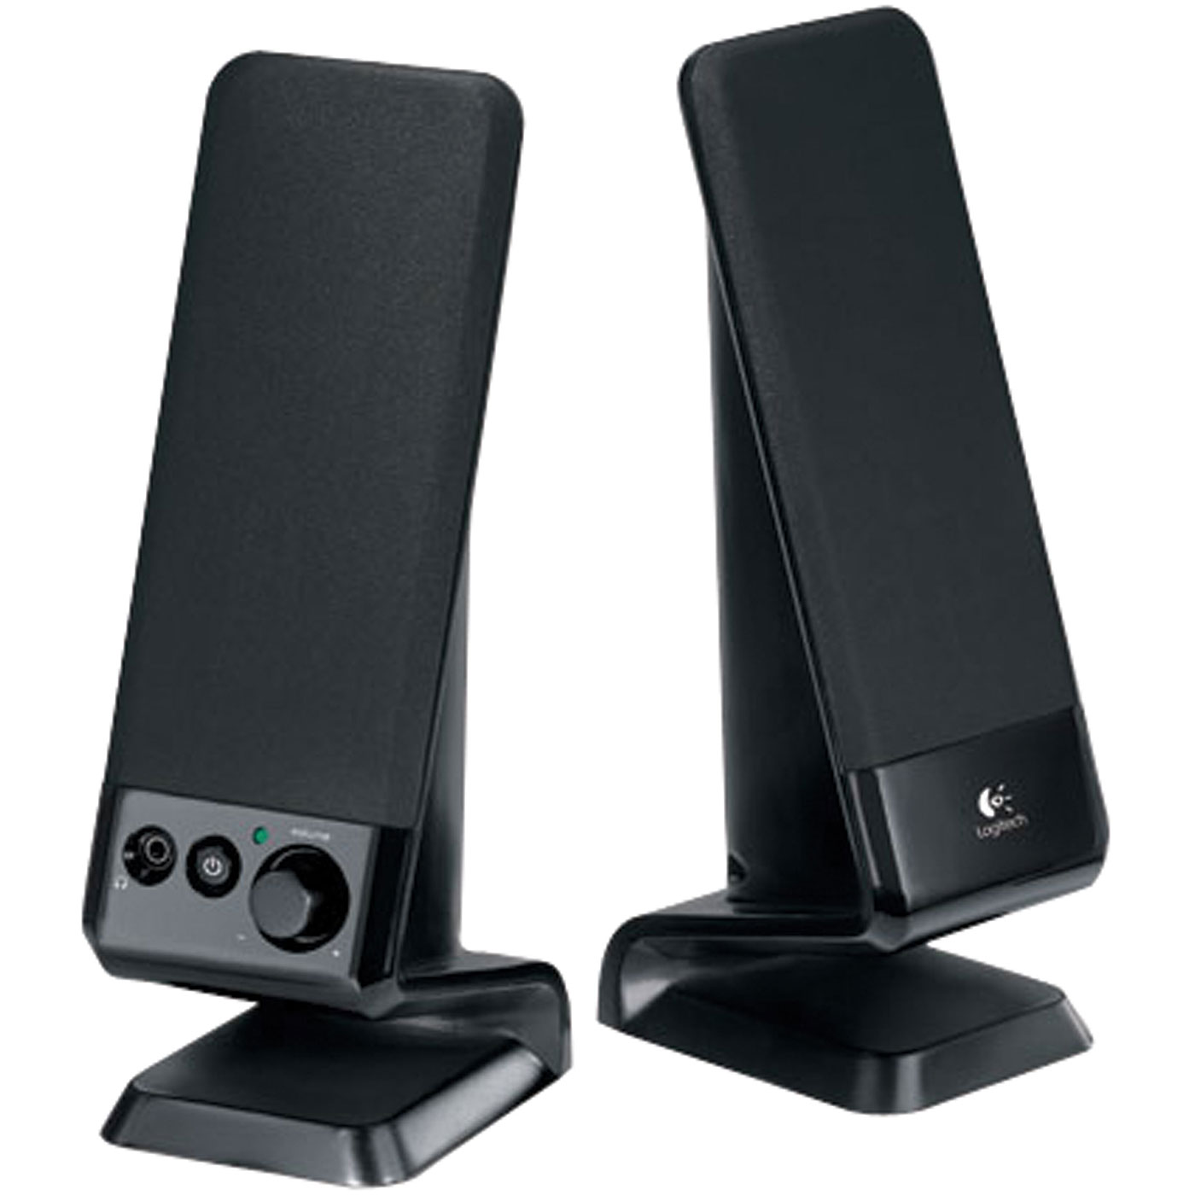
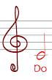
Digitized sound
Computers can render sound by generating a sampled sine function
The computer’s speaker “plays the sample”
y: an array of values that approximates the sound wave function
y
StdAudio.play(arr)
X (time)
StdAudio.play(arr) sends the sequence of the array values to the audio driver, which controls the sound card (hardware), that controls the speakers.

Slide 29
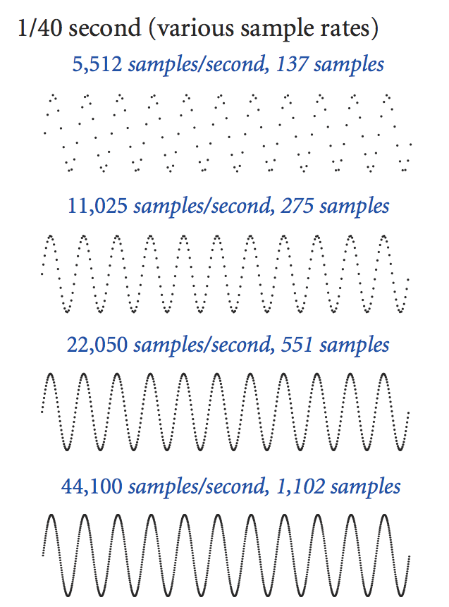
Sampling
1/40 second:
1/40 second:
Sampling rate
Number of samples per second (sps)
CD quality: A commonly used sampling rate, sps = 44100
1/40 second:
1/40 second:
Notes:
Analogous to the code we wrote to plot a function by sampling at a uniformly space set of points
now, we want to *play* the sine wave to a speaker instead of displaying it on the screen

Slide 30
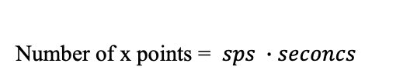
Playing tones (תדרים)
Example: Play a C note (hz = 523.25) for 2 seconds, sps (samples per second) = 44100
Implementation: Create an array (y) that samples the sine wave function, according to the required parameters, and “play the array”, using the function call StdAudio.play(y)
abs
y
x = 0, 1, 2, 3, ...
Number of x points = $sps ∙seconcs$
0
1
2
3
4
5
6
7
...
x

Slide 31
Playing tones (תדרים)
Example: Play a C note (hz = 523.25) for 2 seconds, sps (samples per second) = 44100
Implementation: Create an array (y) that samples the sine wave function, according to the required parameters, and “play the array”, using the function call StdAudio.play(y)
// A library of functions for generating musical notes.
public class Sound {
public static void main(String[] args) {
double pitch = Double.parseDouble(str);
// Creates a tone array representing the given pitch (frequency)
double[] tone = tone(pitch, 3); // plays it 3 seconds
StdAudio.play(tone);
}
// Returns an array representing a sampled sine wave modulated according
// to the given pitch (frequency, in Hz) and seconds, using a sampling
// rate of 44100 values per second.
public static double[] tone(double pitch, double seconds) {
int sps = 44100;
int N = (int) (seconds * sps);
double[] y = new double[N];
for (int x = 0; x < N; x++) {
y[x] = Math.sin(x * pitch * (2 * Math.PI) / sps);
}
return y;
}
}
abs
x = 0, 1, 2, 3, ...
Plays some arbitrary tones:
% java Sound 8526
% java Sound 576
% java Sound 14365

Slide 32
Playing tones (תדרים)
Example: Play a C note (hz = 523.25) for 2 seconds, sps (samples per second) = 44100
Implementation: Create an array (y) that samples the sine wave function, according to the required parameters, and “play the array”, using the function call StdAudio.play(y)
// A library of functions for generating musical notes.
public class Sound {
public static void main(String[] args) {
double pitch = Double.parseDouble(str);
// Creates a tone array representing the given pitch (frequency)
double[] tone = tone(pitch, 3); // plays it 3 seconds
StdAudio.play(tone);
}
// Returns an array representing a sampled sine wave modulated according
// to the given pitch (frequency, in Hz) and seconds, using a sampling
// rate of 44100 values per second.
public static double[] tone(double pitch, double seconds) {
int sps = 44100;
int N = (int) (seconds * sps);
double[] y = new double[N];
for (int x = 0; x < N; x++) {
y[x] = Math.sin(x * pitch * (2 * Math.PI) / sps);
}
return y;
}
}
abs
Plays Do Re Mi:
% java Sound 523.25
% java Sound 587.23
% java Sound 659.26

Slide 33
Playing notes (תווים)
// A library of functions for generating musical notes.
public class Sound {
public static void main(String[] args) {
// Plays Do, Re, Mi, each for 0.5 second.
StdAudio.play(note(3, .5));
StdAudio.play(note(5, .5));
StdAudio.play(note(7, .5));
}
// Returns an array representing a sampled sine wave modulated according
// to the given pitch (frequency, in Hz) and seconds, using a sampling
// rate of 44100 values per second.
public static double[] tone(double pitch, double seconds) {
int sps = 44100;
int N = (int) (seconds * sps);
double[] y = new double[N];
for (int x = 0; x < N; x++) {
y[x] = Math.sin(x * pitch * (2 * Math.PI) / sps);
}
return y;
}
// Returns an array representing the given musical note, and seconds.
// (0 is A, 1 is A#, 2 is B, 3 is C, 4 is C#, ...).
public static double[] note(int i, double seconds) {
return tone(440.0 * Math.pow(2, i / 12.0), seconds);
}
...
}
pitch(i) = 440 * 2^{i/12}
Plays Do Re Mi:
% java Sound

Slide 34
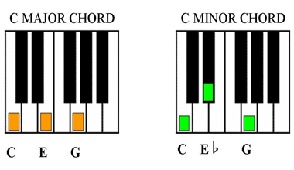
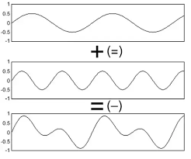
Playing chords (אקורדים)
// A library of functions for generating musical notes.
public class Sound {
public static void main(String[] args) {
// Plays the Do-major chord (Do, Mi and Sol), for 5 seconds
StdAudio.play(chord(3, 7, 10, 5));
}
// Tone and Note functions come here
// Returns the weighted sum of two given arrays, using two given weights.
public static double[] sum(double[] a, double[] b, double awt, double bwt) {
double[] c = new double[a.length];
for (int i = 0; i < a.length; i++)
c[i] = a[i] * awt + b[i] * bwt;
return c;
}
// Returns a 3-note chord by combining the three given notes.
public static double[] chord(int i1, int i2, int i3, double seconds) {
double[] a1 = note(i1, seconds);
double[] a2 = note(i2, seconds);
double[] a3 = note(i3, seconds);
// builds and returns an equal mix of the three notes
double[] s = sum(a1, a2, .5, .5);
s = sum(s, a3, .5, .5);
return s;
}
}
abs

Slide 35
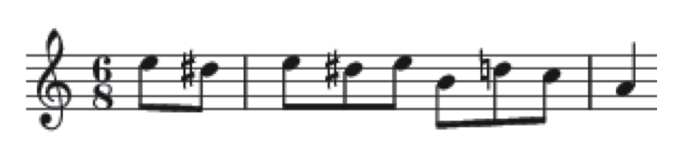
Playing tunes (לחנים)
Elise (Beethoven):
// A library of functions for generating musical notes.
public class Sound {
public static void main(String[] args) {
In in = new In(fileName);
while (!in.isEmpty()) {
int i = in.readInt();
double seconds = in.readDouble();
StdAudio.play(note(i, seconds));
}
}
// All the other Sound functions come here
}
% more elise.txt
7 .3
6 .3
7 .3
6 .3
7 .3
2 .3
5 .3
3 .3
0 1.0
% java Sound elise.txt
(we’ll hear the first 9 notes of Elise)

Slide 36
Introduction to Computer Science
Shimon Schocken
IDC Herzliya
Lecture 6-1
Multimedia, Part II
Notes:
36

Slide 37
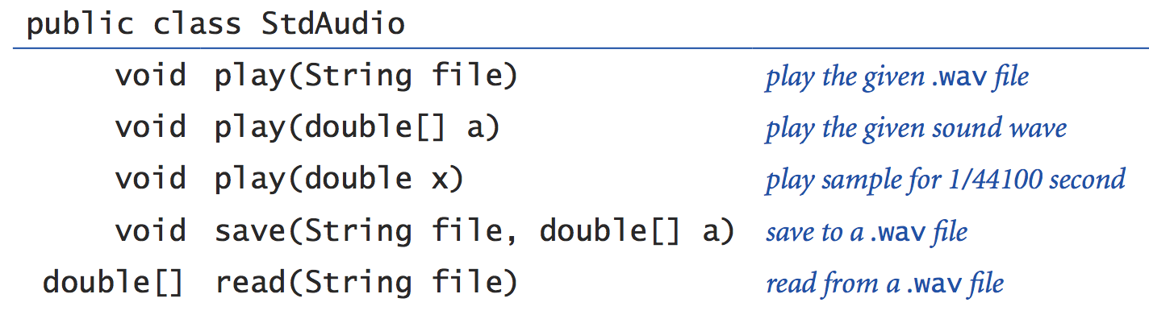
StdAudio: A library for playing digital audio
Complete API:
Google “class StdAudio API”

Slide 38
Concluding observations
StdAudio: Library for generating audio
Sound: Library for handling notes and music
Benefits:
Modular design
Code re-use
Consistency
A new “language” (API) for sound processing (we have to add Javadoc)
We can extend the language at will
Functions:
The most important abstraction in software engineering.
“Programmers are creators of universes for which they alone are responsible. Universes of virtually unlimited complexity can be created in the form of computer programs.” (Joseph Weizenbaum)

Slide 39
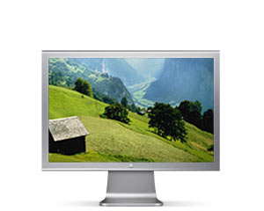
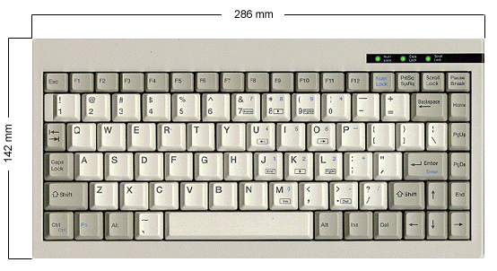
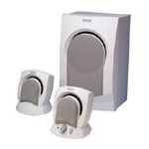
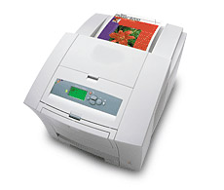
The big picture
part of the host OS
device driver
device driver
supplied by Java
Java I/O libray
Java I/O libray
friendly abstraction
StdDraw class
StdIn class
your Java program
application programmer’s I/O view
(in this course)
StdAudio class
StdOut class
Java I/O libray
Java I/O libray
Same basic software hierarchy for every I/O device
device driver
device driver

Slide 40
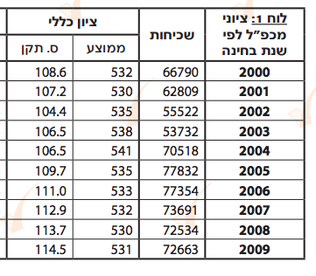

Gaussian distribution
Standard Gaussian distribution
"Bell curve”
Models / predicts how values are distributed in numerous social and physical science phenomena.
mean μ = 530 and standard deviation σ = 110
310
420
530
640
750
40

Slide 41
Revisiting the big picture
part of the host OS
device driver
device driver
part of the JDK
Java I/O libray
Java I/O libray
friendly abstraction
standard draw
standard input
your Java program
application programmer’s “world view”
standard audio
standard output
Java I/O libray
Java I/O libray
Same basic software hierarchy for every I/O device
device driver
device driver

Slide 42
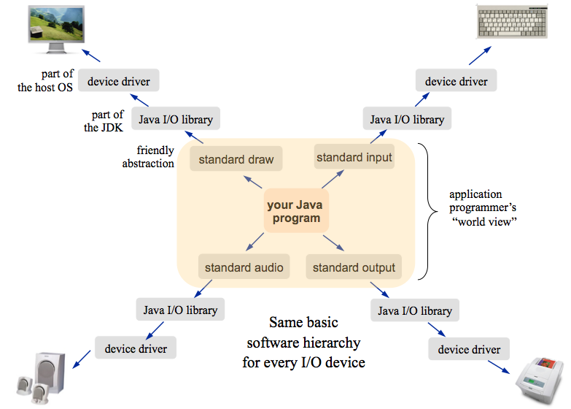
Revisiting the big picture
Practical observations:
strict separation between hardware and software
as the hardware changes, there is no need to touch the application software: we just need a new device driver
the power of abstractions
Theoretical observation:
a computer program is a finite machine that can process an infinite stream of data
These are some of the most important observations in applied CS

Slide 43
Tunes (לחנים)
B D C A A B C B A
% more elise.txt
7 .3
6 .3
7 .3
6 .3
7 .3
2 .3
5 .3
3 .3
0 1.0
0 .3
2 .3
11 .3
2 .3
3 .3
7 .3
6 .3
7 .3
6 .3
7 .3

Slide 44
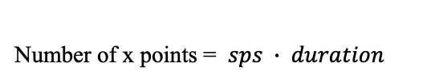
Sampling
Abstraction: Play the note C (523.35 hz) for 2 seconds
Math: Sine wave properties: hz = 523.25, duration = 2 seconds, samples per second (sps) = 44100 (default)
Implementation:
Create an array (let’s call it y) that samples this sine wave
“Play the array”, using the function call StdAudio.play(y)
y
Number of x points = $sps ∙ duration$
0
1
2
3
4
5
6
7
...
x

Slide 45
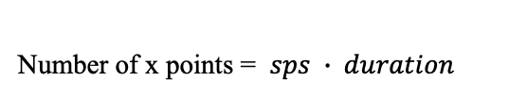
Pitch
Abstraction: Play the note C (523.35 hz) for 2 seconds
Math: Sine wave properties: hz = 523.25, duration = 2 seconds, samples per second (sps) = 44100 (default)
Implementation:
Create an array (let’s call it y) that samples this sine wave
“Play the array”, using the function call StdAudio.play(y)
y
0
1
2
3
4
5
6
7
...
x
Number of x points = $sps ∙ duration$

Slide 46
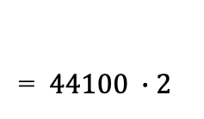
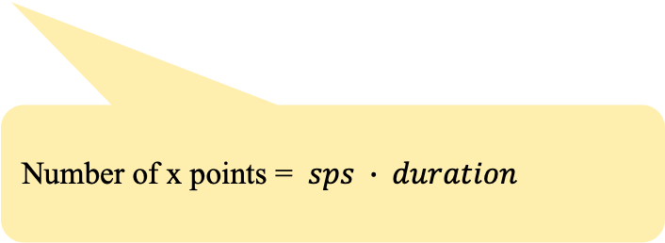
Pitch
Abstraction: play the note C (523.35 Hz) for 2 seconds
Implementation:
Sine wave properties: hz = 523.25, duration = 2 seconds
Create an array (let’s call it toneArr) that represents a sampling of this sine wave, using 44100 samples per second (default)
“Play the array”, using the function StdAudio.play(toneArr)
// Returns an array representing the sine wave values associated with
// playing the given pitch (frequency, in Hz) for the give duration
// (seconds), using a sampling rate of 44100 cycles per second.
public static double[] tone(double pitch, double seconds) {
int sps = 44100;
int N = (int) (seconds * sps);
double[] y = new double[N];
for (int x = 0; x < N; x++) {
y[x] = Math.sin(x * pitch * (2 * Math.PI) / sps);
}
return y;
}
}
y
Number of x points = $sps ∙ duration$
0
1
2
3
4
5
6
7
...
x
= $44100 ∙2$

Slide 47
Pitch
Abstraction: play the note C (523.35 Hz) for 2 seconds
Implementation:
Sine wave properties: hz = 523.25, duration = 2 seconds
Create an array (let’s call it y) that represents a sampling of this sine wave, using 44100 samples per second (default)
“Play the array”, using the function StdAudio.play(y)
y
0
1
2
3
4
5
6
7
...
x

Slide 48
Chords (אקורדים)
public class Sound {
// Returns the pitch of the given i-the note, in Hz
private static double pitch(int i) {
return 440.0 * Math.pow(2, i / 12.0);
}
// Returns the pitch of the given note, in Hz
private static double pitch(String str) {
if (str.equals("A")) { return pitch(0); }
if (str.equals("A#") || str.equals("Bb")) { return pitch(1); }
if (str.equals("B")) { return pitch(2); }
if (str.equals("C")) { return pitch(3); }
if (str.equals("C#") || str.equals("Db")) { return pitch(4); }
if (str.equals("D")) { return pitch(5); }
if (str.equals("D#") || str.equals("Eb")) { return pitch(6); }
if (str.equals("E")) { return pitch(7); }
if (str.equals("F")) { return pitch(8); }
if (str.equals("F#") || str.equals("Gb")) { return pitch(9); }
if (str.equals("G")) { return pitch(10); }
if (str.equals("G#") || str.equals("Ab")) { return pitch(11); }
return 0.0; // compilation requirement
}
}
abs
pitch(i) = 440 * 2^{i/12}

Slide 49
Sound class code
// A library of functions for generating musical notes.
public class Sound {
public static void main(String[] args) {
//// Uncomment the action you want to execute.
// demo1(args[0]); // Plays a given tone
// demo2(); // Plays Do Re Mi
// demo3(); // Plays Do, and then the chord Do-Major
// demo4(args[0]); // Plays music from a file
}
// Test: Plays a given tone
public static void demo1(String str) {
double pitch = Double.parseDouble(str);
// Creates a tone array representing the given pitch (frequency)
double[] tone = tone(pitch, 3); // plays it 3 seconds
StdAudio.play(tone);
}
// Test: Plays Do, Re, Mi, each for 0.5 second.
public static void demo2() {
StdAudio.play(note(3, .5));
StdAudio.play(note(5, .5));
StdAudio.play(note(7, .5));
}
// Test: Plays Do for 3 seconds,
// and then the Do-major chord (Do, Mi and Sol) for 3 seconds each
public static void demo3() {
StdAudio.play(note(3, 3));
StdAudio.play(chord(3, 7, 10, 3));
}
// Test: Reads from a file, and plays, a sequence of (i, seconds) notes
public static void demo4(String fileName) {
In in = new In(fileName);
while (!in.isEmpty()) {
int i = in.readInt();
double seconds = in.readDouble();
StdAudio.play(note(i, seconds));
}
}
// Returns an array representing a sampled sine wave modulated according
// to the given pitch (frequency, in Hz) and seconds, using a sampling
// rate of 44100 values per second.
public static double[] tone(double pitch, double seconds) {
int sps = 44100;
int N = (int) (seconds * sps);
double[] y = new double[N];
for (int x = 0; x < N; x++) {
y[x] = Math.sin(x * pitch * (2 * Math.PI) / sps);
}
return y;
}
// Returns an array representing the given musical note, and seconds.
// (0 is A, 1 is A#, 2 is B, 3 is C, 4 is C#, ...).
public static double[] note(int i, double seconds) {
return tone(440.0 * Math.pow(2, i / 12.0), seconds);
}
// Returns the weighted sum of two given arrays, using two given weights.
public static double[] sum(double[] a, double[] b, double awt, double bwt) {
double[] c = new double[a.length];
for (int i = 0; i < a.length; i++)
c[i] = a[i] * awt + b[i] * bwt;
return c;
}
// Returns a 3-note chord by combinig the three given notes.
public static double[] chord(int i1, int i2, int i3, double seconds) {
double[] a1 = note(i1, seconds);
double[] a2 = note(i2, seconds);
double[] a3 = note(i3, seconds);
// builds and returns an equal mix of the three notes
double[] s = sum(a1, a2, .33, .33);
s = sum(s, a3, .5, .5);
return s;
}
}

Slide 50
Introduction to Computer Science
Reichman University
Lecture 6-1
Multimedia, Part II
Notes:
50

